Slide 1



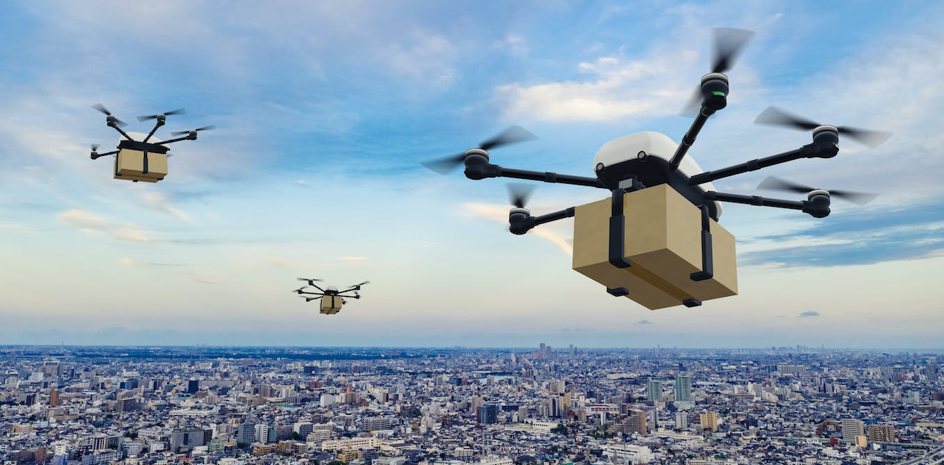
Final Presentation Designing a multi-agent physical simulation
Students: Saar Stern, Yamit Pisman
Supervisor: Ayal Taitler
Semester: Spring, 2023
Date: 21/01/24

Slide 2
Outline
Project goal
Background
Our work
Results
Summary and future work

Slide 3
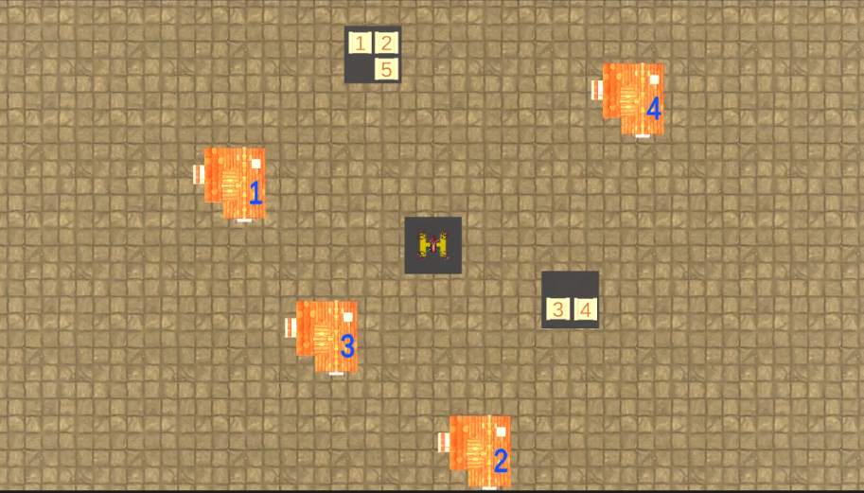
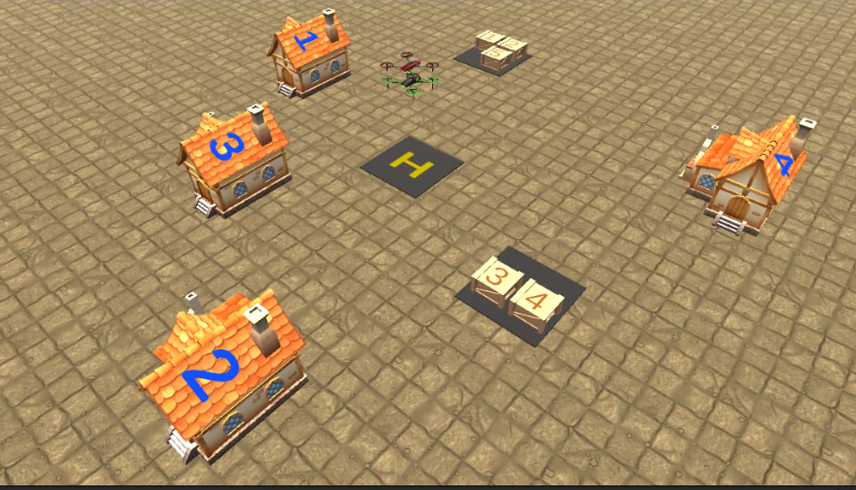
Project Goal
Design drone's pickup and delivery physical simulation, which contains time and space synchronization.
Notes:
להתייחס לציורים: יש לנו רחפנים, בתים חבילות, מנחת

Slide 4
Constraints
Physical constraints:
max velocity
max acceleration
battery
Temporal - spatial constraints:
some houses accept deliveries only in a time window. (e.g., house 3 accept deliveries in 14:00-16:00)
Metric:
minimal overall time
minimal battery use
Notes:
להסביר למה הבעיה קשה ומעניינת

Slide 5
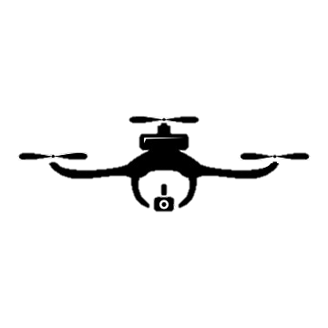

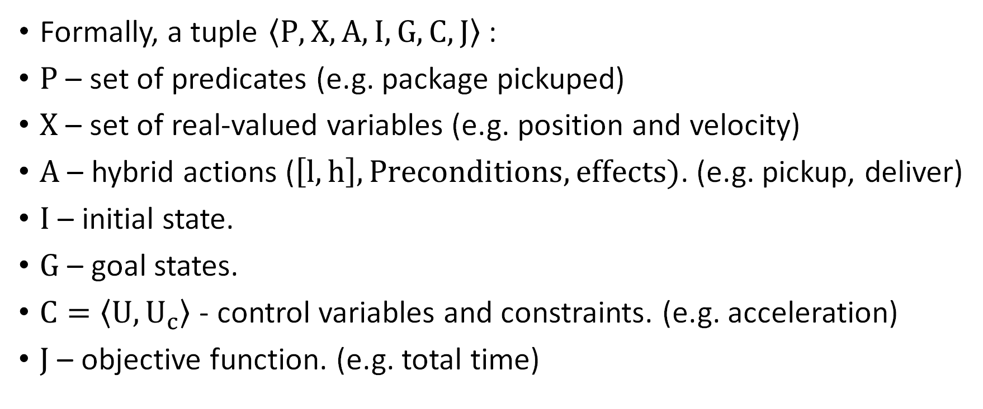
Temporal Planning Problem
Formally, a tuple $〈P,X,A,I,G,C,J〉$ :
$P$ – set of predicates (e.g. package pickuped)
$X$ – set of real-valued variables (e.g. position and velocity)
$A$ – hybrid actions ($\left[l,h\right], Preconditions,effects)$. (e.g. pickup, deliver)
$I$ – initial state.
$G$ – goal states.
$C=\left\langle U,U_{c}\right\rangle$ - control variables and constraints. (e.g. acceleration)
$J$ – objective function. (e.g. total time)
Notes:
להסביר שהמודל שקול לבעיית חיפוש בעץ
ובנוסף לסדר הפעולות, צריך להתחשב בזמנים.

Slide 6

PDDL - Planning Domain Definition Language
Domain
Predicates
Functions
(continuous variables)
Actions\operators
Problem
Initial state
Goal
Metric
Notes:
הDOMAIN מכיל גם אילוצים על המשתנים הרציפים.

Slide 7
General Scheme
Domain knowledge
Generate PDDL
Planning Model (No acc)
Adjust model
Planner
No
Plan
Post Processing (add acc)
Physical?
Yes
Simulation
Notes:
מדובר בבעיות קשות, ולעיתים הפלאנר מוגבל למהירות ולסדר הפעולות, ולכן את המעבר לבקרה פיזיקלית אמיתית, נעשה בpost processing.

Slide 8
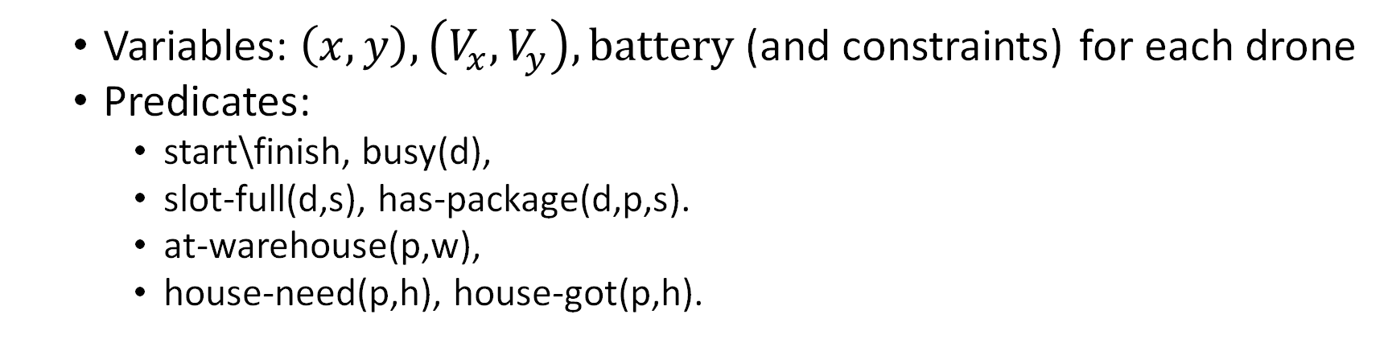
State space
Variables: $\left(x,y\right),\left(V_{x},V_{y}\right),battery$ (and constraints) for each drone
Predicates:
start\finish, busy(d),
slot-full(d,s), has-package(d,p,s).
at-warehouse(p,w),
house-need(p,h), house-got(p,h).
Drone – d1, d2, …
Package – p1, p2, p3,..
Warehouse – w1, w2, ..
House – h1, h2, h3, h4, ..
Slot – s1, s2..
Actions
Start , finish(d).
pickup(d,p,w,s)
deliver(d,h,p,s)
Notes:
איזה פעולות אנחנו רוצים שרחפן יעשה?

Slide 9
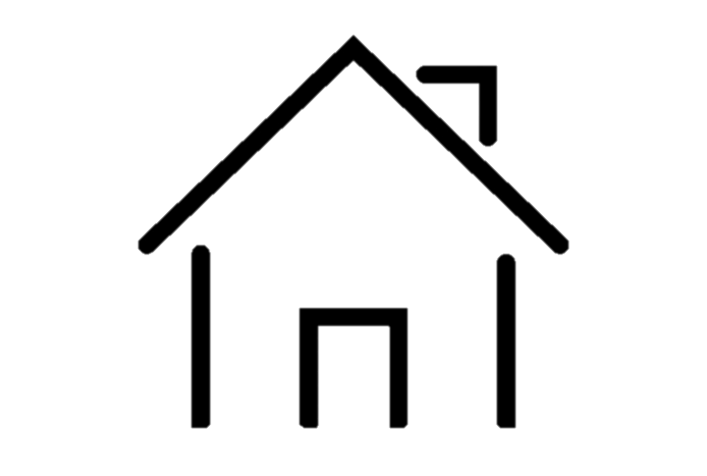
Fly no-Fly
 | Fly
 | Pickup
 | Fly
 | Delivery
 | Pickup
 | Delivery
Notes:
יש שתי גישות איך לגרום לרחפן לזוז..

Slide 10
Time windows
time constraints on PDDL actions.
Window 0
Window 1
t
0

Slide 11
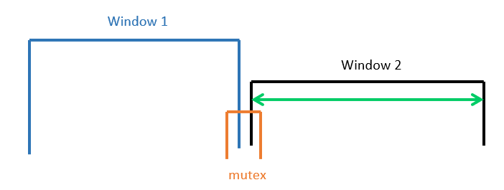
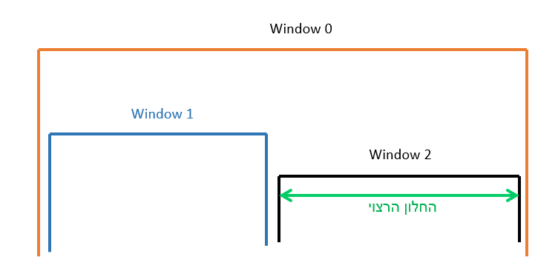
Alternatives
PDDL variable (function) that increase with time.
Mutex Mechanism
3. Three windows
Notes:
האם להשאיר את השקף?

Slide 12

Metrics
(:metric minimize (+
(* -0.1 (drone1-battery))
(* -0.1 (drone2-battery))
(* 20 (total-time) )
)
)
$$decrease is∝|V_{1}|$$
Alternatives we tried
Drone1-time
Drone2-time
$decrease is$ $∝\left(\left|V_{1}\right|+1\right)$
→ More realistic
𝑑𝑒𝑐𝑟𝑒𝑎𝑠𝑒 𝑖𝑠 ∝(|𝑉_1 |+1)
→ More realistic

Slide 13
ScottyActivity planner
Starting state
Starting state
Start A1
Starting state
Start A2
Start A1
Start A3
Start A2
Start A1
Start A2
Search for path
Finish A2
Optimization of all continuous variables
Finish A2
Finish A1
Start A2
Start A3
Finish A1
Finish A1
Start A3
Start A3
Finish A3
Finish A3

Slide 14
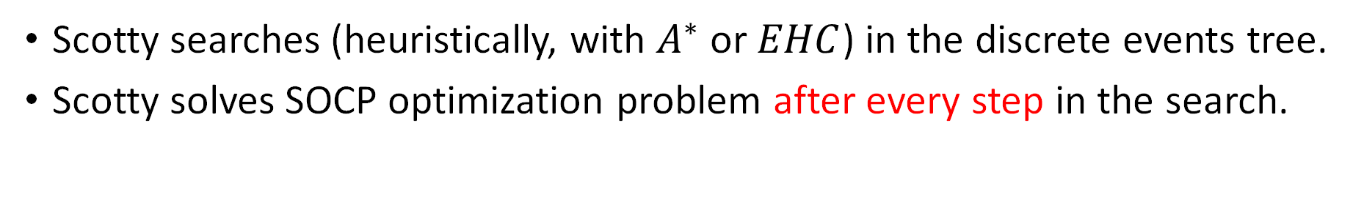
ScottyActivity planner
Scotty searches (heuristically, with $A^{∗}$ or $EHC$) in the discrete events tree.
Scotty solves SOCP optimization problem after every step in the search.
PDDL files
Plan
Problem & Domain
Scotty
Json file

Slide 15
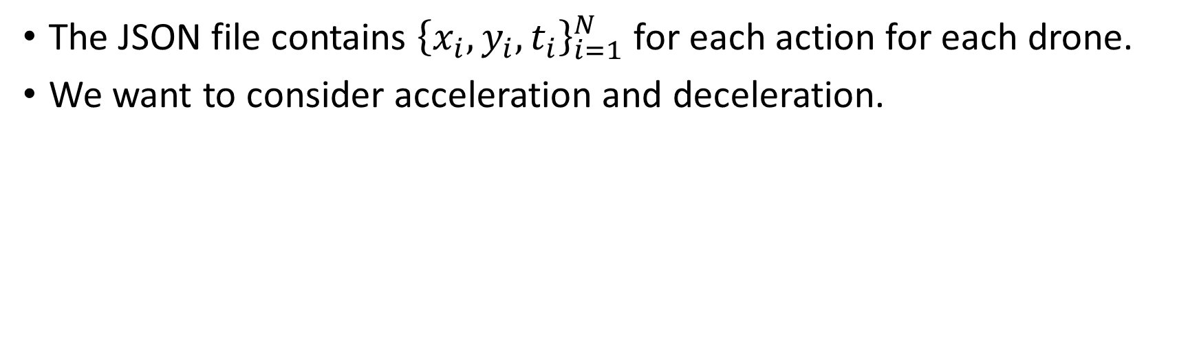
route planning
The JSON file contains ${\left\{x_{i},y_{i},t_{i}\right\}}_{i=1}^{N}$ for each action for each drone.
We want to consider acceleration and deceleration.
Velocity
Scotty’s output
Wanted output
V
Vend
Vstart
Acceleration
Deceleration
T1
T2
T3
Time
Action 1
Action 2

Slide 16
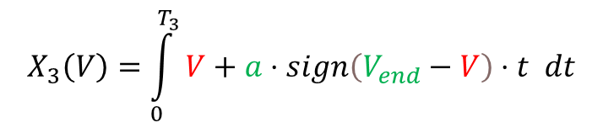

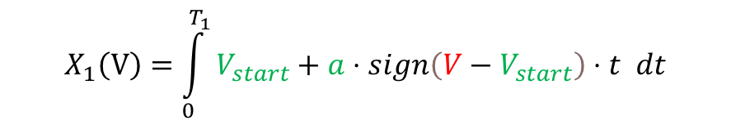
Physical feasibility test
$$T_{1}=\frac{\left|V−V_{start}\right|}{a}, T_{2}=\frac{\left|V−V_{end}\right|}{a}, T_{3}=Total time−T_{1}−T_{2}$$
$$X_{1}\left(V\right)=\int_{0}^{T_{1}}{V_{start}+a⋅sign\left(V−V_{start}\right)⋅t dt}$$
$$X_{2}\left(V\right)=T_{3}⋅V$$
Velocity
V
$$X_{3}\left(V\right)=\int_{0}^{T_{3}}{V+a⋅sign\left(V_{end}−V\right)⋅t dt}$$
Vend
$$Total distance\left(V\right)=\left(X_{1}+X_{2}+X_{3}\right)\left(V\right)$$
Vstart
Acceleration
Deceleration
T1
T2
T3
Time

Slide 17
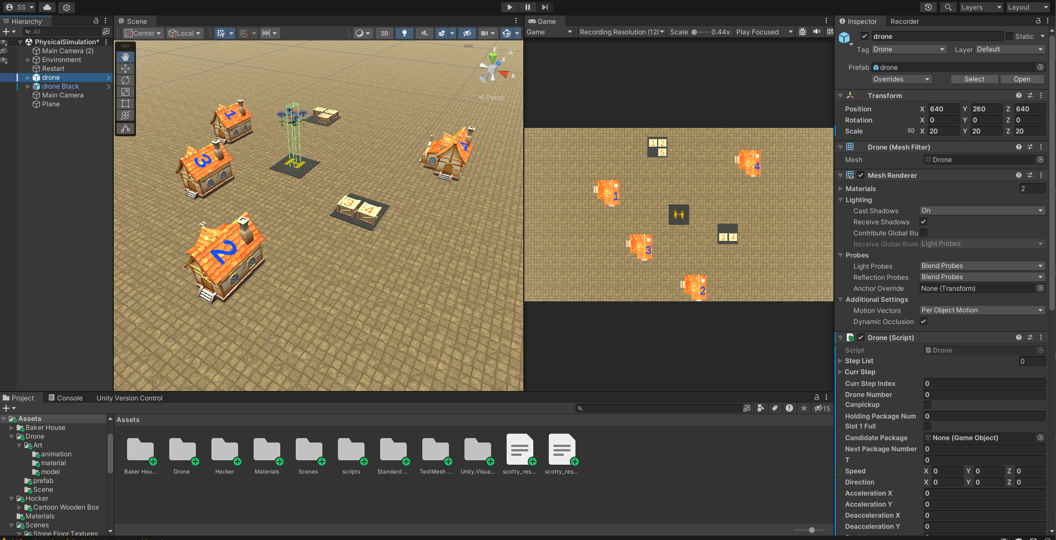
Unity

Slide 18
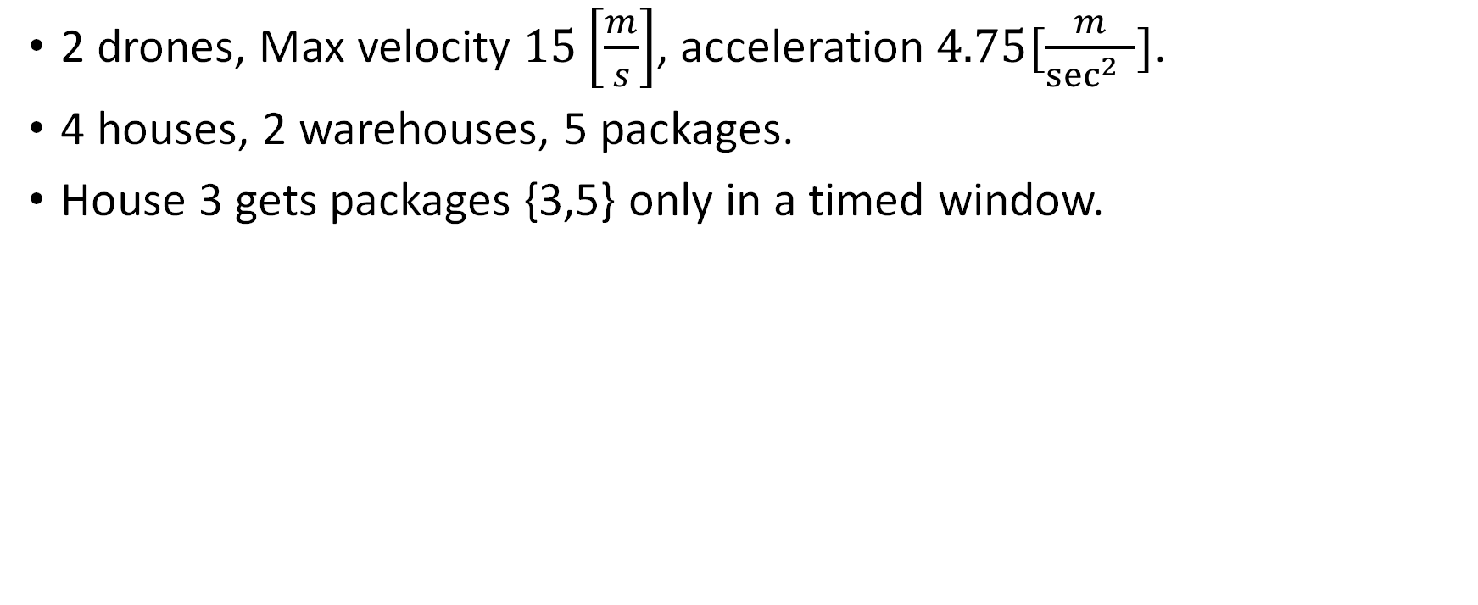
Our scenario
2 drones, Max velocity $15\left[\frac{m}{s}\right]$, acceleration $4.75[\frac{m}{\sec^{2}{ }}]$.
4 houses, 2 warehouses, 5 packages.
House 3 gets packages {3,5} only in a timed window.

Slide 19
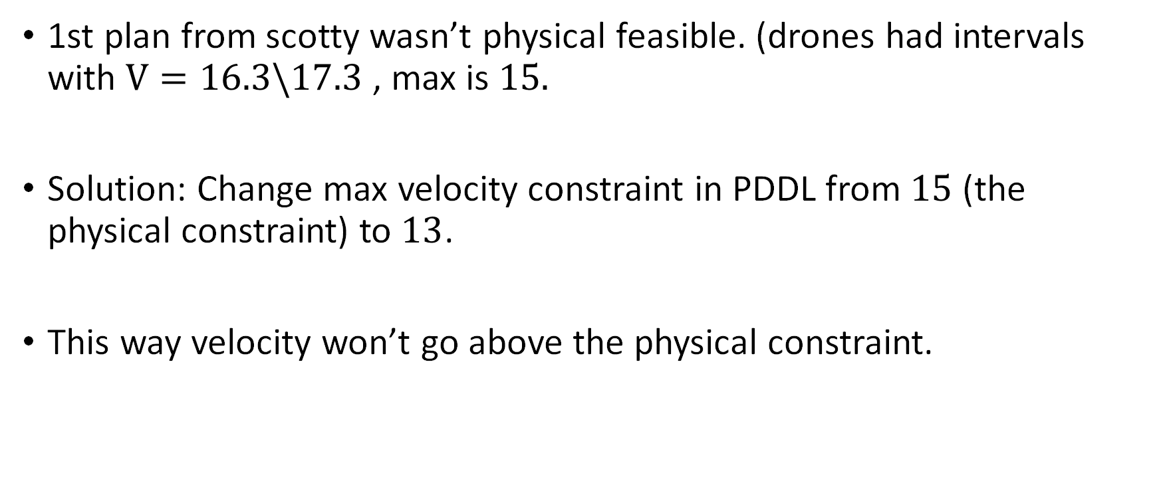
Feedback
1st plan from scotty wasn’t physical feasible. (drones had intervals with $V=16.3\backslash 17.3$ , max is $15.$
Solution: Change max velocity constraint in PDDL from $15$ (the physical constraint) to $13$.
This way velocity won’t go above the physical constraint.

Slide 20
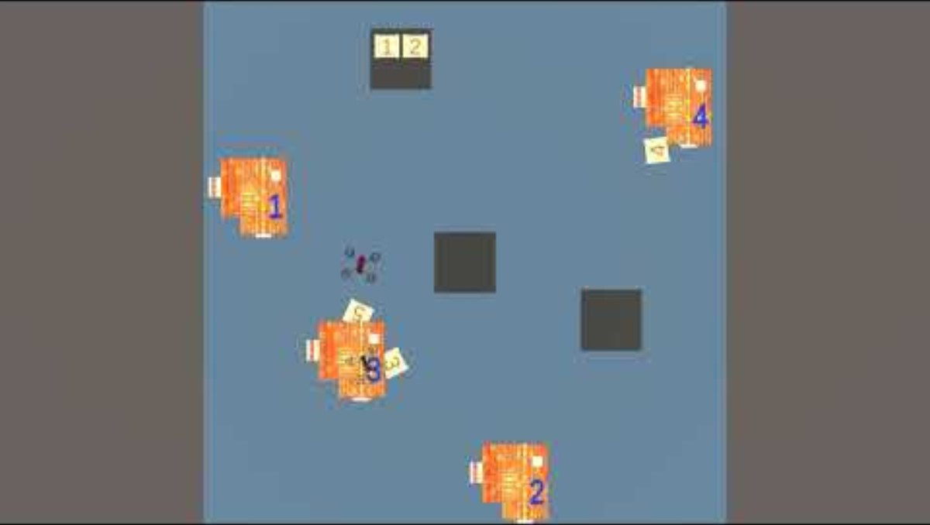
Middle time interval – [150,180]
PhysicalSimulation - YouTube

Slide 21
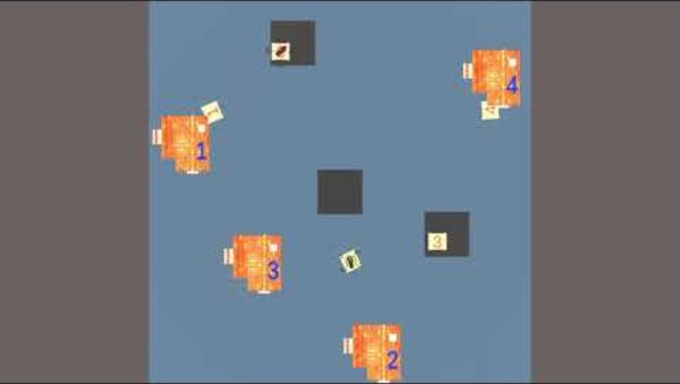
Late time interval – [220,260]
Physical simulation - late interval

Slide 22
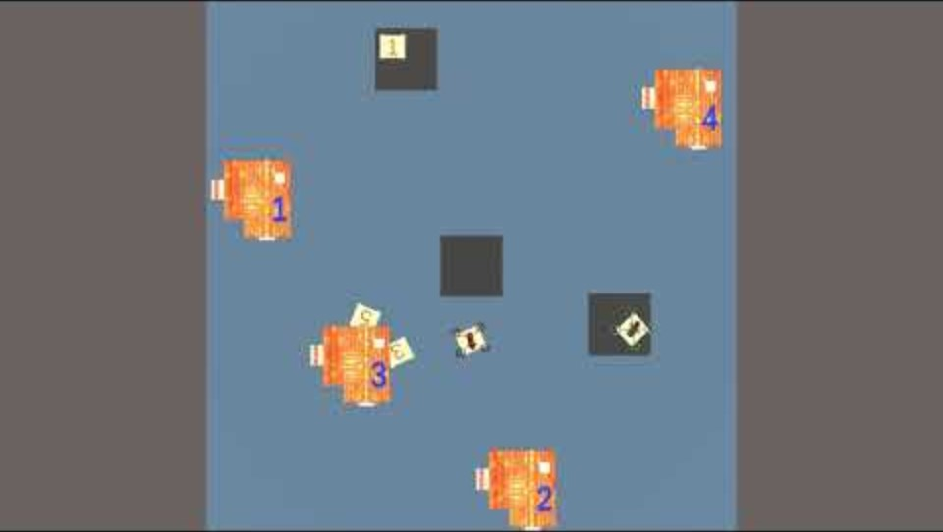
Early time interval – [50,90]
Physical simulation - early interval

Slide 23
Summary
Spatial-temporal planning problem
Generate PDDL according to problem (with time intervals)
Study and use ScottyActivity – advanced planner.
Physical Plan by solving physical equations.
Simulation with Unity.
Feedback
Overall, whole scheme for Physical Simulation.

Slide 24
Future Work
Introducing consideration of air friction when calculating speed and acceleration.
Battery waste even if 0 velocity.
Combining tasks with space and time constrains for both drones simultaneously – shipping one package together.
Introduction of prohibited areas for passage – no fly zone.

Slide 25
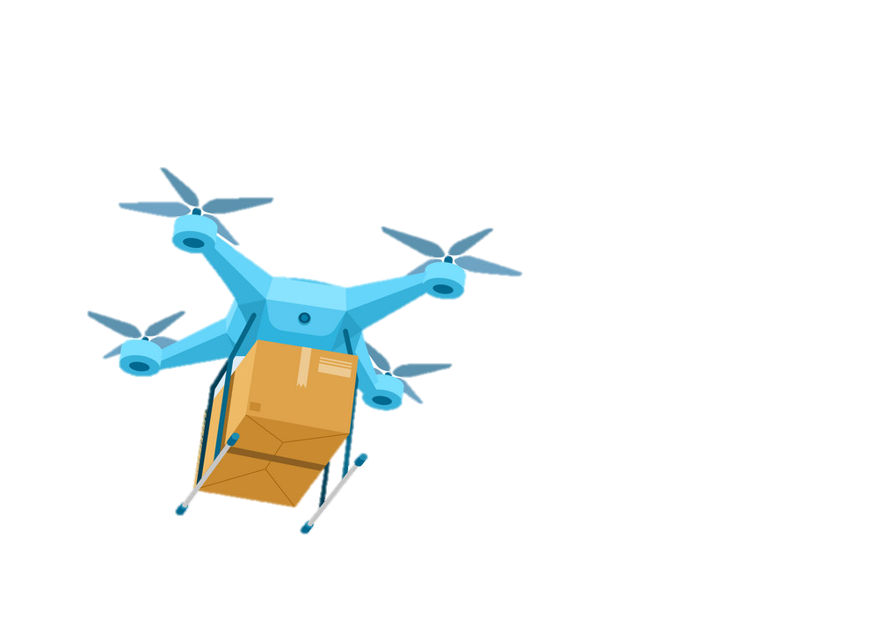
Thank you for listening

Slide 26
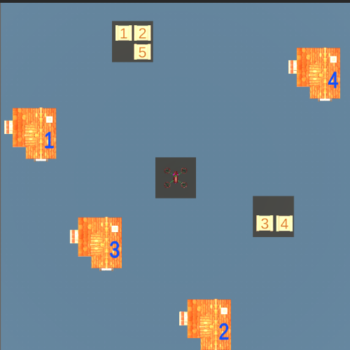
Fly or no-Fly
pickup
pickup
FLY

Slide 27
Scalability

Slide 28
Literature Survey
[1] Taitler, A. et al. (2019) Minimum Time Validation for Hybrid Task Planning, icaps19.icaps-conference.org. Available at: https://icaps19.icaps-conference.org/workshops/PlanRob/PlanRob_2019_submissions/PlanRob_2019_paper_1.pdf (Accessed: 04 December 2023).
[2] Fernandez-Gonzalez, E. Mixed Discrete-Continuous Planning with Complex Behaviors. In The 26th International Conference on Automated Planning and Scheduling (p. 48).
[3] Temporal Planning as Heuristic Search. (n.d.). Google Docs. https://docs.google.com/presentation/d/1N5gc__kmY3TE9cHqFg2zM8yT1zxehTc710nCRk6otxM/edit#slide=id.g221c7f3818_1_0
[4] An Introduction to PDDL Introtopddl2.pdf (toronto.edu)
[5] Planning.wiki - the AI Planning & PDDL Wiki. https://planning.wiki/
[6] Matrice 600 - Product Information - DJI. (n.d.). DJI Official. https://www.dji.com/global/matrice600/info

Slide 29
Domain and Problem Knowledge
How many Drones?
How many houses and warehouses?
Where is each house?
…
GeneratePDDL()
Models of domain & problem
PDDL
Feedback
scotty
PhysicalPlan()
Physical plan (per drone)
Json format
Plan
json format
Simulation
Unity

Slide 30
Starting state
Start A1
Start Action
Start A2
Finish Action
Finish A1
Start A3
Finish A3
Time
Notes:
העץ מציג את כל מה שאפשרי, והפתרון הוא לבדוק את האופציות.
EVENT – אנחנו מגבילים את עצמנו לevent driven.

